Slide 1
CS6501/ECE6501 IoT Sensors and Systems
August 30, 2017
Brad Campbell – bradjc@virginia.edu
http://www.cs.virginia.edu/~bjc8c/class/cs6501-f17/

Slide 2
An Analysis of a Large Scale Habitat Monitoring Application
Robert Szewczyk, Alan Mainwaring, Joseph Polastre, John Anderson, and David Culler
SenSys 2004

Slide 3
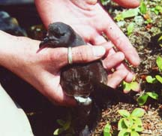
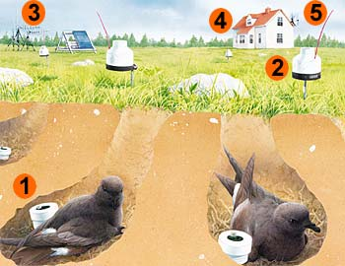
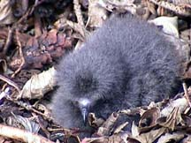
Goal: monitor a habitat with a longitudinal study
1 measurement per hour

Slide 4
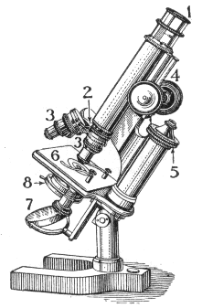
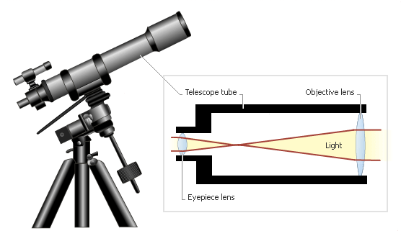
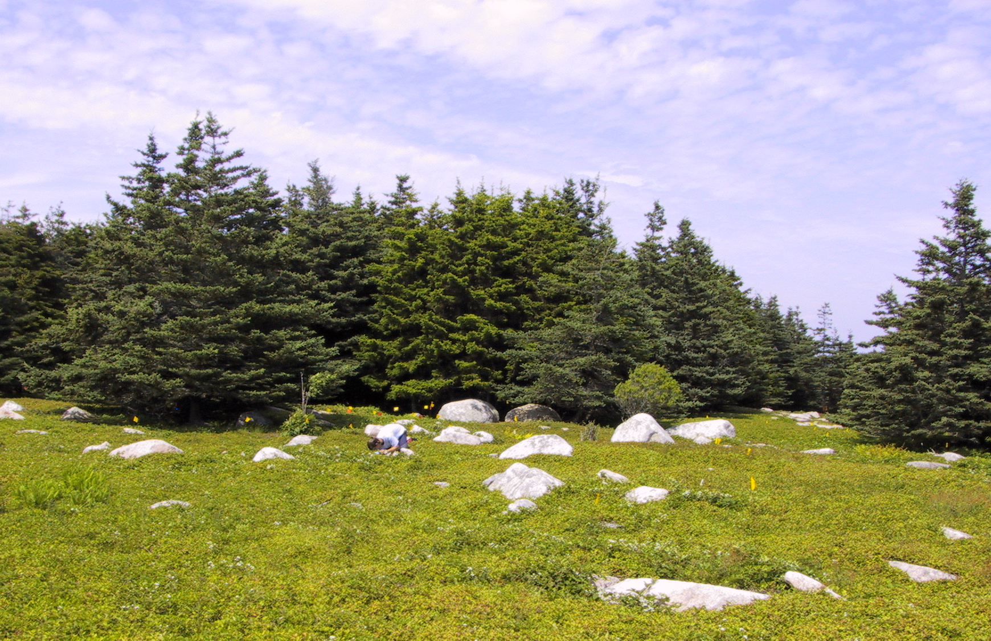
How? With a “macroscope”
Study of very small
Microbiology
Microscope
Study of very large
Astronomy
Telescope
Study of very complex
Ecology, sociology,…
Macroscope

Slide 5
Why Wireless Sensor Networks?
“Individual devices can be made sufficiently numerous to take measurements at many locations of interest, and mitigate errors arising from the interpolation and extrapolation from coarser-grained samples.”
“Wireless telemetry is valuable because it minimizes observer effects, study site intrusions and environmental alterations.”

Slide 6
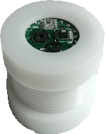
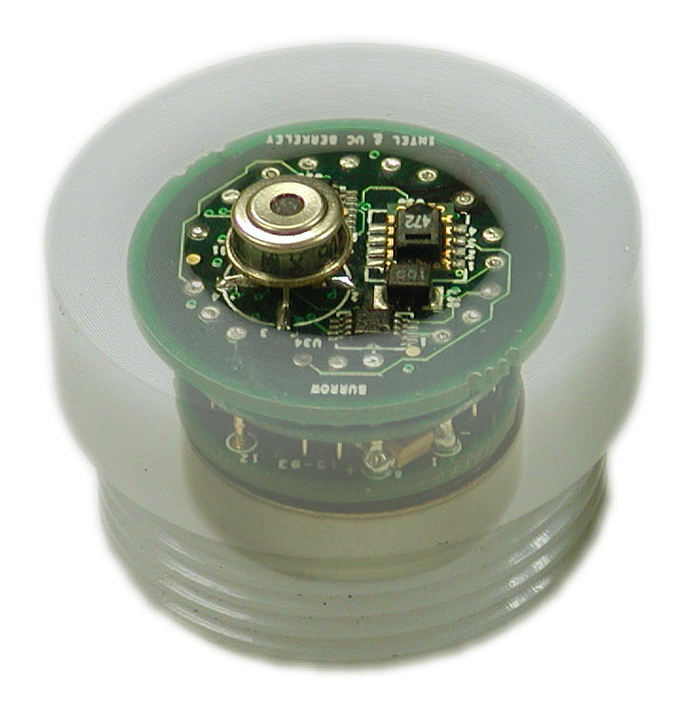
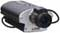

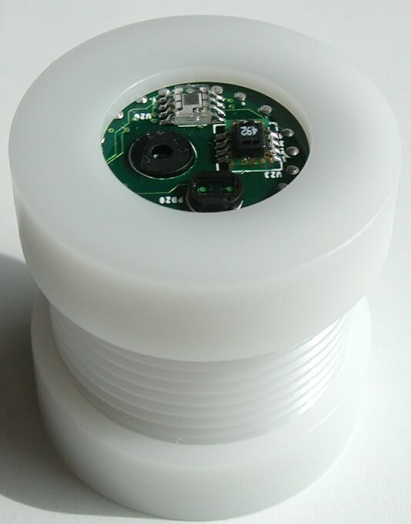
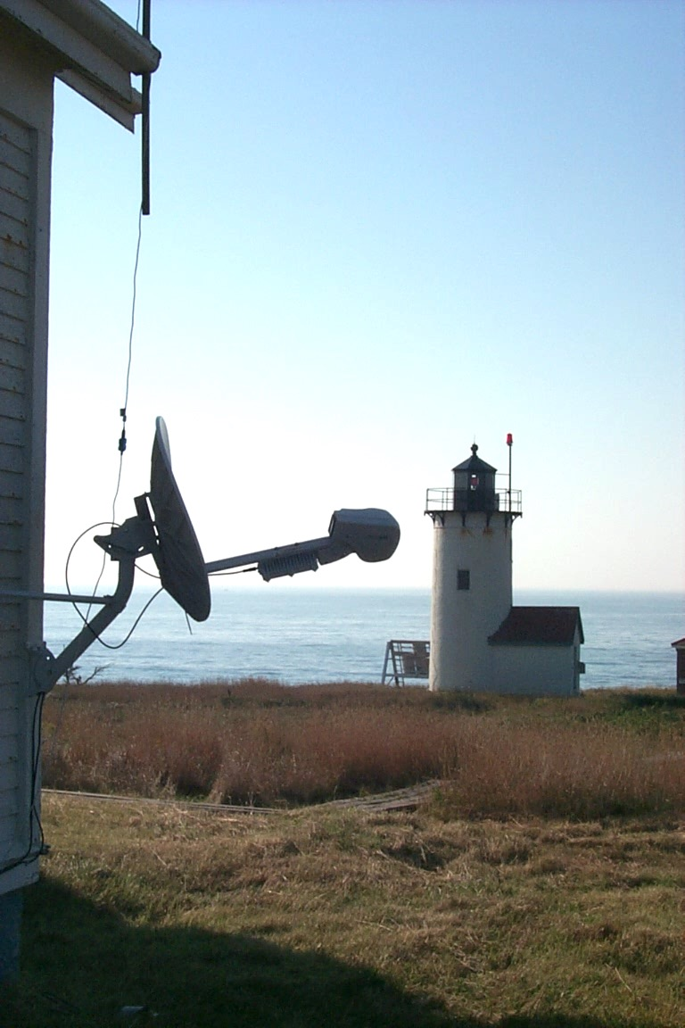
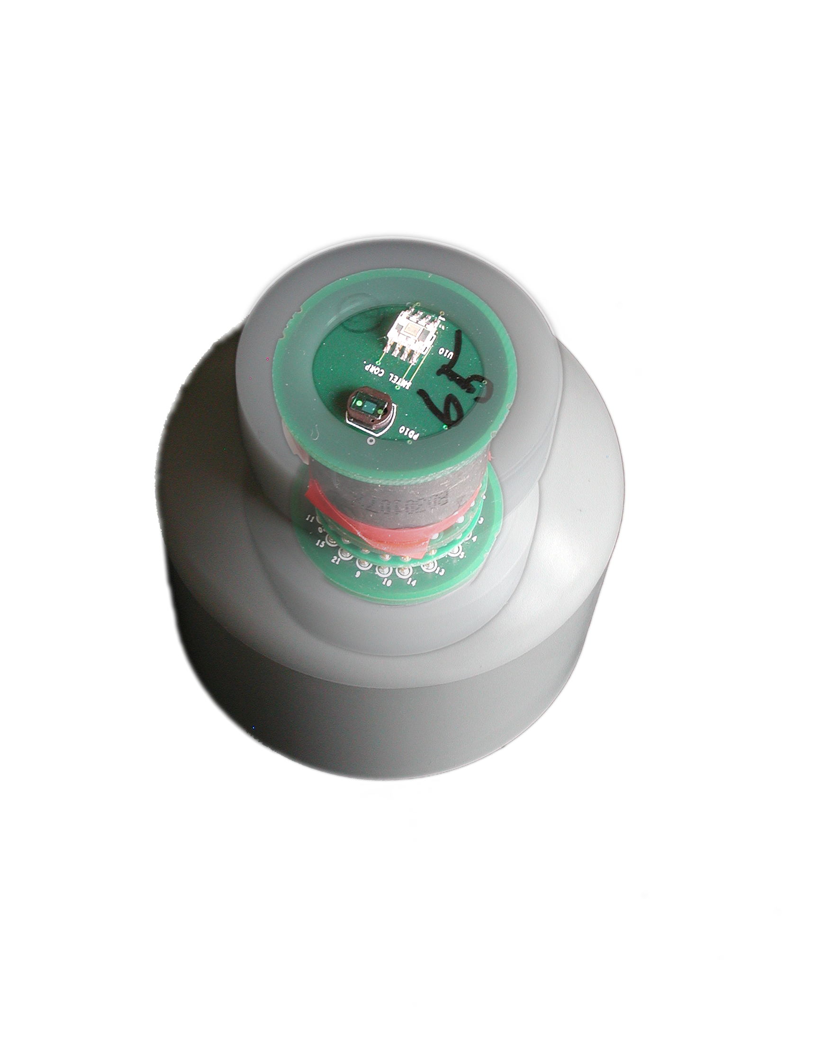
Approach
Sensor Patches
Verification Network
Gateway
Single Hop Network
Transit Network
Gateway
Client Data Browsing
and Processing
Gateway
Multi Hop Network
Base station
Site WAN Link
Internet
“streaming data architecture” and oversampling

Slide 7
Analysis of the deployment
Collect sensor data (obviously)
Also collect some routing data
Analyze the network performance
Packet reception
Node longevity
Did they meet their sensing goal?

Slide 8
What was their hypothesis? Were there multiple?
An analysis of the network from a real wireless sensor network deployment will highlight areas for further research, and provide suggestions for future deployments.
A properly programmed low power WSN using batteries can provide four months of ecologically useful data on the nesting habits of petrels.
Oversampled data communicated in a simple but lossy “streaming” fashion will meet measurement and deployment goals while being simpler to implement.

Slide 9
What did they find? Deployments are hard!
basestation
Shutdown for hurricane Isabel

Slide 10
What surprised you?

Slide 11
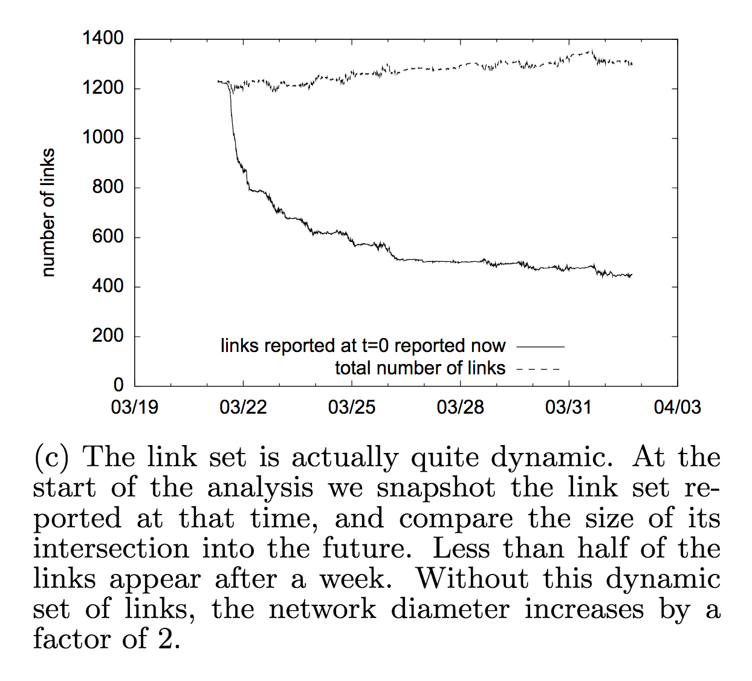
Links aren’t stable
@Scale – SDH, et. al (IPSN’12)

Slide 12
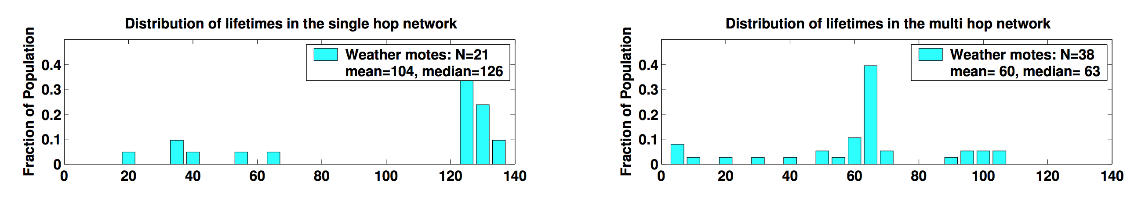
Not surprising: single-hop out performed multi-hop in lifetime

Slide 13
Other thoughts?

Slide 14
Information Bang for the Energy Buck: Towards Energy- and Mobility-Aware Tracking
Philipp Sommer, Jiajun Liu, Kun Zhao, Branislav Kusy, Raja Jurdak, Adam McKeown, and David Westcott
EWSN’16
Best paper

Slide 15
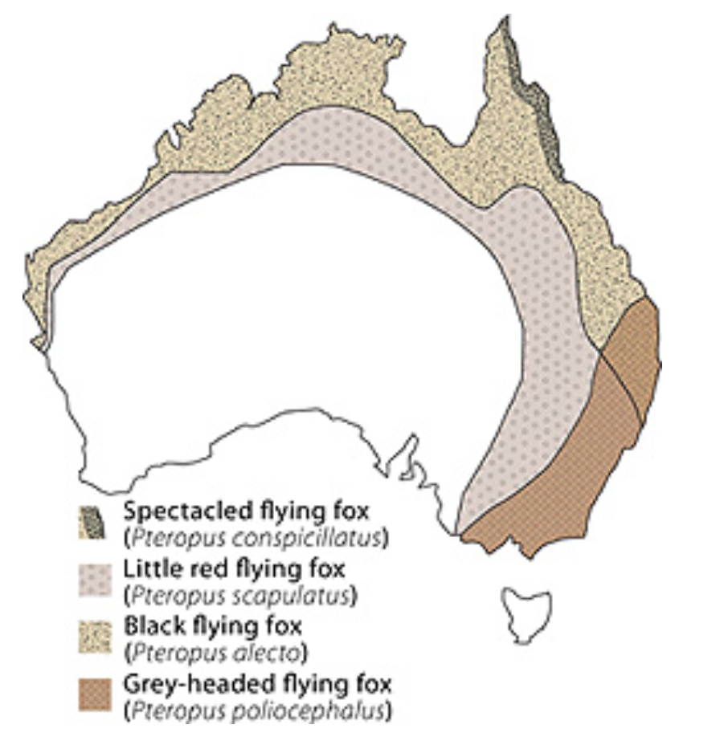


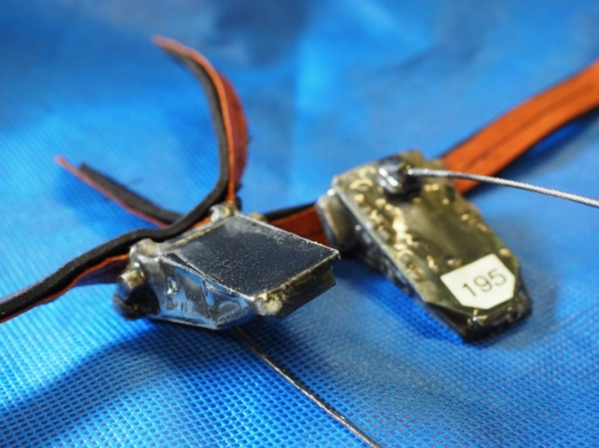
Tracking flying foxes in Australia

Slide 16
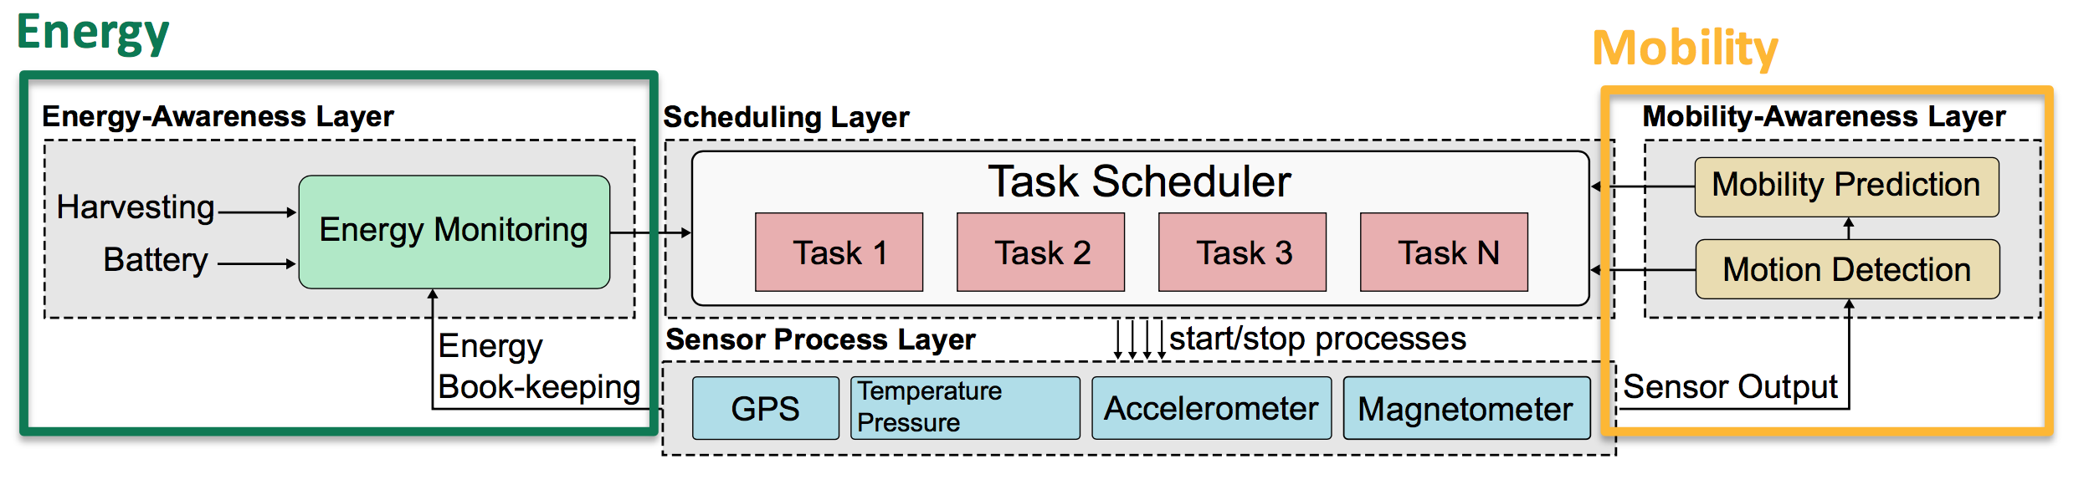
Fix energy, and try to improve tracking accuracy
Rather than the typical, fix accuracy and reduce energy.
Energy may be changing, but use what we have to get the best traces possible.

Slide 17
Hypothesis of this paper?
“Historical movement patterns can be used to forecast movement in the near future” and these patterns “coupled with instantaneous estimates of displacement” from “low power inertial sensors” will enable a GPS sampling strategy that performs better than periodic sampling and motion based sampling.

Slide 18
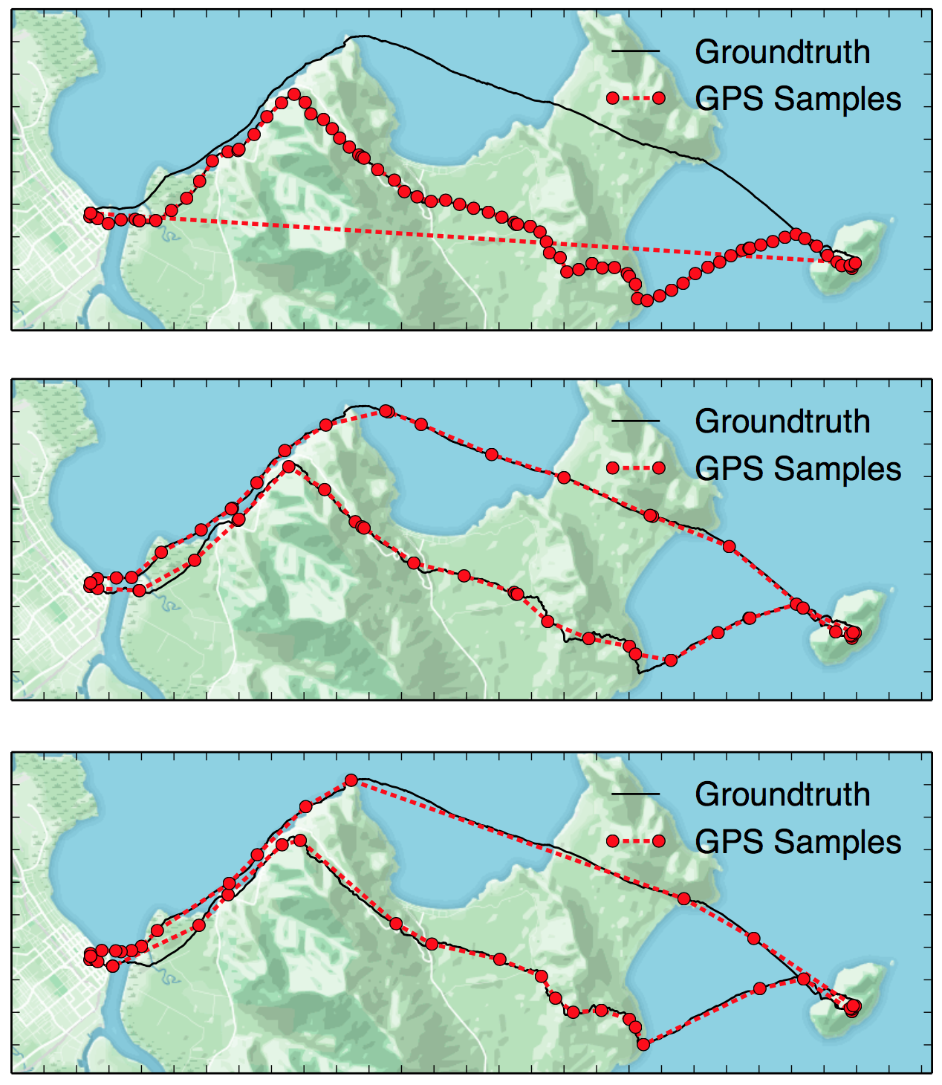
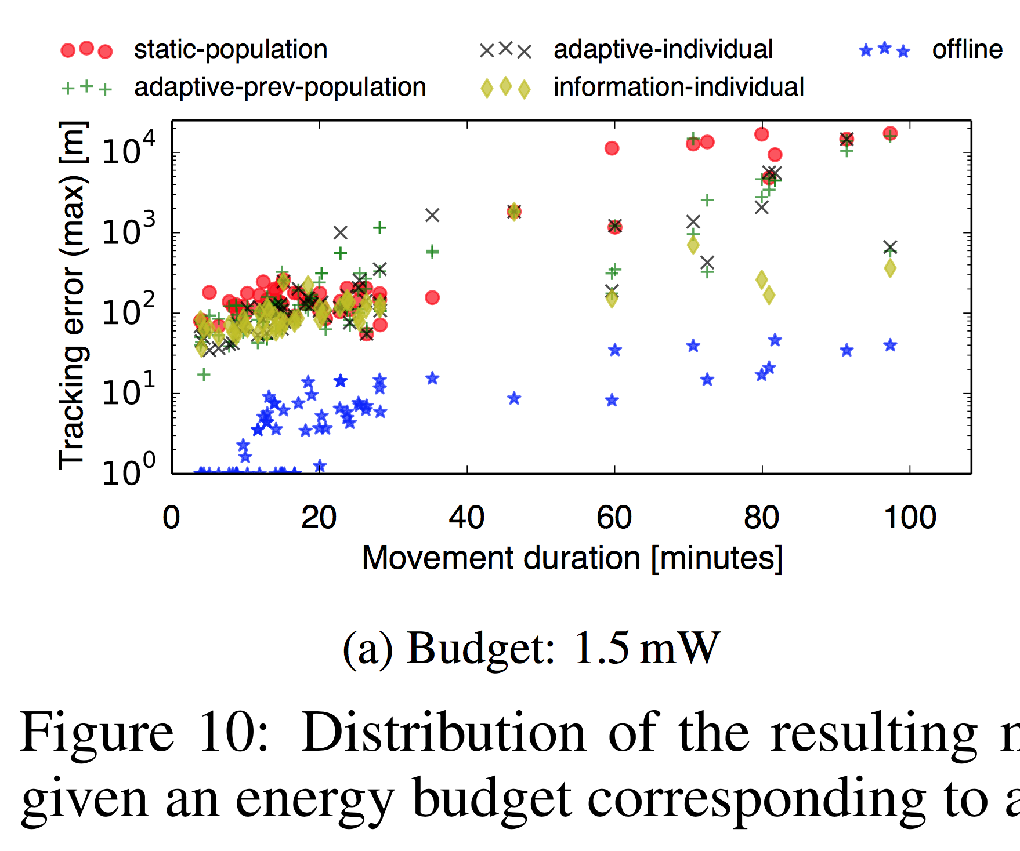
Did they prove that?

Slide 19
Strengths of these papers?

Slide 20
Weaknesses?

